Slide 1
KPDailyCheckup
Developing the product
Product Owner: Maleina Bidek
© 2019 Udacity. All rights reserved.

Slide 2
Create Project Blueprint
A product launch is not just about deploying a beautifully designed,built and thoroughly tested feature. Your company needs to be equally prepared if not more to support every possible customer interaction associated with the product (e.g landing on your company website to learn more about the new feature)
© 2019 Udacity. All rights reserved.
Notes:
[ALL PARTICIPATION]

Slide 3
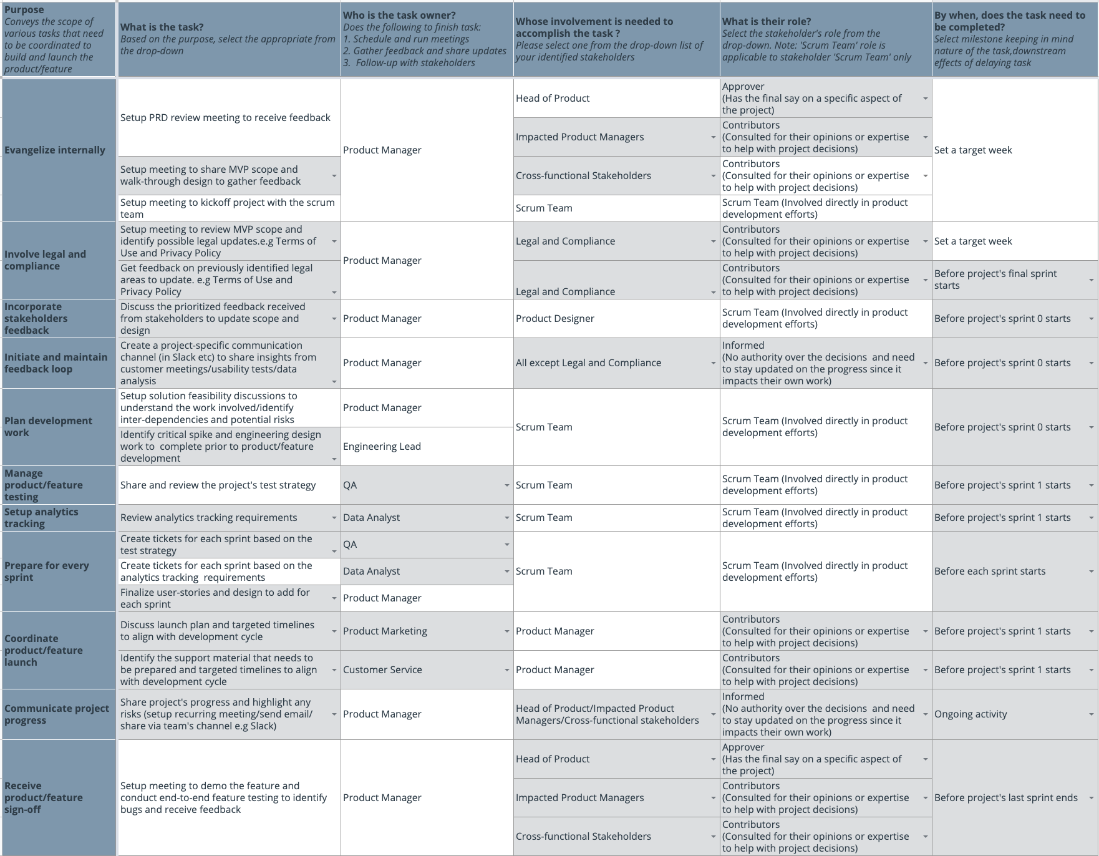
Create a coordination activities map
Please view my coordination activities map here here if you have trouble viewing the screenshot below.
© 2019 Udacity. All rights reserved.

Slide 4
Plan for Sprint Meeting
As a PM, it is important to stay ahead of your scrum team and be prepared for every upcoming sprint by having a target goal defined with prioritized backlog for team to start costing and breaking down the tasks
© 2019 Udacity. All rights reserved.
Notes:
[ALL PARTICIPATION]

Slide 5
Sprint Planning Meeting Preparation
Sprint Goal
Implement a minimum viable product to address the weight management aspect of preventative care. The app will include authentication via member login, a well as activity and food logging to track progress towards the user’s weight goal.
Sprint Backlog
1 | As a Kaiser Permanente member, I want to be able to create an account with my member ID, so that I can log into and use the app.
2 | As a user, I want to be able to enter my current weight and target weight so that the app can recommend an action plan.
3 | As a user, I want to be able to enter in the type and amount of physical activity that I’ve done, so that the app can calculate how many calories I have burned and count it towards my daily goal.
4 | As a user, I want to be able to enter in the foods that I have eaten, so that the app can calculate how many calories I have consumed and count it towards my daily goal.
5 | As a user, I want to be able to view the meals and activity that I’ve logged and their corresponding calories, so that I can see how I am advancing towards my goal.
Sprint Prioritization Logic
We need to have a functional product at the end of the sprint and all of the stories in the sprint backlog result in a basic weight management product. Metrics collected from this initial launch can subsequently be used to obtain information regarding the user’s journey through the product to identify further features and/or refinements. According to the product roadmap, weight management was one of the first areas that we want to implement since it is the basis of many preventing many chronic diseases.
© 2019 Udacity. All rights reserved.

Slide 6
User Story 1
User Story | As a user, I want to be able to view the meals and activity that I’ve logged and their corresponding calories, so that I can see how I am advancing towards my goal.
Design | Link to Mockup (For this sprint, the ’Water’ and ‘Sleep’ sections do not need to be developed.)
Acceptance Criteria | The user has clicked on ‘Daily Log’ from the hamburger menu or clicked on the ‘Log’ button from the bottom navigation bar to get to the ‘Daily Log’ screen. The screen and its associated data load almost instantly. In the ’Food’ section of the screen, the user sees the food items and their corresponding calorie amounts that they’ve logged for the day, grouped by meal (Breakfast, Lunch, Snack, Dinner). Additionally the total calories for the meal are displayed next to the meal name. In the ’Exercise’ section of the screen, the user can see the physical activity that they’ve logged, as well as the corresponding calories that they’ve burned for each. There should be a grand total of calories burned next to the ’Exercise’ label. A generally representative icon is displayed next to each logged item, for example, a chicken drumstick next to a logged chicken item. If there is no logged data for a meal, the user sees the meal name (Breakfast, Lunch, Snack, Dinner), followed by the ‘+’ button. Likewise, for Exercise, the user will see the ‘Exercise’ label followed by the ‘+’ button. The user can swipe left on a logged item to delete it. The calorie count for it’s corresponding category is adjusted accordingly. When the user clicks on the ‘+’ next to a meal name, they are taken to the ‘Log Food’ screen. (See User Story 2) When the user clicks on any of the logged food items, they are taken to a nutrition summary page for that item where they are able to edit the quantity consumed of that item. The quantity must be a positive amount, otherwise the user must receive an error saying that they should enter a value greater than 0. The calorie amount will be updated automatically depending on the quantity value entered. The user can click ’Save’ to save the modification or ’Cancel’ to cancel. In either case, they are returned to the ‘Daily Log’ and the corresponding calorie amount for the item and the total of its corresponding category will be updated if the quantity changed. When the user clicks on the ‘+’ in the ‘Exercise’ section, they are taken to the ‘Log Exercise’ screen. (Acceptance criteria are in the corresponding user story.) When the user clicks on any of the logged exercises, they are taken to an exercise summary page and are able to edit the amount of time exercised for that item. This must be a positive amount, otherwise the user must receive an error saying that they should enter a value greater than 0. The calories burned will be updated automatically depending on the time value. They can click ’Save’ to save the modification or ’Cancel’ to cancel. In either case, they are returned to the ‘Daily Log’ and the corresponding calories and totals burned will be updated if the amount of exercise changed. All functionality works on both iPhones and Android devices. The app does not yet support the integration of third party apps and tracking devices.
Assumptions | The logic to log and modify meals and exercises has already been developed. We have access to icons for each activity type and food type or food item.
© 2019 Udacity. All rights reserved.

Slide 7
User Story 2
User Story | As a user, I want to be able to enter in the foods that I have eaten, so that the app can calculate how many calories I have consumed and count it towards my daily goal.
Design | Link to Mockup
Acceptance Criteria | On the Daily Log, user clicks on ‘+’ button to add a food item to a meal and is taken to the ’Log Foods’ page. User can search for food items by name against a large database via a search box. The search results should start to appear as the user types. The user can also search for foods by clicking the ‘Scan Barcode’ button, then scanning the code of the item. If the user has not yet given the app permission to access the device’s camera, they should be prompted to do so. If the bar code isn’t recognized, an error should display saying that a bar code code was not recognized. If there is any delay in retrieving search results, it should not be more than a few seconds and a ’Searching’ message should appear on the screen during that time. If there is no match for the search, the user should receive a message saying that no results were found and that they may add the item manually by clicking on the ’New Food’ button. If the user clicks on the ’New Food’ button, they can create a new food item by entering the name, quantity and calorie information themselves. The name must contain at least one character, otherwise the user must receive an error saying that they should enter a name with at least one character. The quantity amount must be positive, otherwise the user must receive an error saying that they should enter a value greater than 0. The calorie amount must be non-negative, otherwise the user should receive an error saying that they should enter a non-negative value. When user selects a food item (either from the search results or the list of recent foods), they are taken to the ‘Nutritional Information’ page for that item where they can edit the quantity consumed (must be positive), then click the ’Add’ button to add the item to their log and return to the ‘Log Foods’ page. Alternatively they can click the ‘Cancel’ button to return back to the ‘Log Foods’ page. If the user does not enter a positive quantity consumed, then they should receive and error saying that they should enter a value greater than 0. After the user has chosen all of the food items they want to add, they can click the ’Done’ button to return to the Daily Log. All functionality works on both iPhones and Android devices. The app does not yet support the integration of third party apps and tracking devices.
Assumptions | We are able to integrate a nutritional information database that contains a large number of food items and their corresponding nutritional information. The database can be searched by item name and barcode. The app will be available in the U.S. only and nutritional information will use Imperial (American) units.
© 2019 Udacity. All rights reserved.

Slide 8
Decoding API Documentation
As a PM, you will collaborate with the engineering team and provide guidance that heavily influences their development approach. When a product requires an API integration, sometimes PM need to be “technical enough” to understand the following to refine the solution with designer and development team
what information is available via the API
how is it available
possible pricing impact
© 2019 Udacity. All rights reserved.
Notes:
[ALL PARTICIPATION]

Slide 9
KPDailyCheckup Project
Based on the API documentation how would you update your solution and design? | Given the vast number of devices that Validic is able to support with relative ease and pending cost approval, we should use it to collect activity, nutrition and other health data and remove our restriction that only certain smart devices provided by Kaiser Permanente should be supported. We will need to revisit our design for connecting devices and apps and integrate Validic’s App Marketplace.
Based on your high-level understanding of the API documentation, are there any details that you want to discuss with engineering to refine solution and/or determine feasibility | The Validic API does not support some popular devices such as the Apple Watch. How will it complicate development and what potential conflicts could arise because we will need to call multiple APIs? Will we allow multiple devices of the same type to connect to the app and, if so, how will we handle conflicts? (For example, the user connects two fitness trackers.)

Slide 10
Re-prioritize Sprint Backlog
As a PM, unexpected issues and new feature requests will require you to triage them efficiently and re-prioritize the sprint backlog without impacting the roadmap deliverables significantly
© 2019 Udacity. All rights reserved.
Notes:
[ALL PARTICIPATION]

Slide 11
Issue 1: Landing Page loading too slow
Determine impact and criticality to prioritize issue | Reproduced the problem myself and verified that the issue was consistent and not just occurring at peak usage times. Confirmed that the bounce rate is much higher than expected with respect to an established baseline, which suggests that users are frustrated and leaving the app. Worked with the team’s data analyst to confirm the negative impacts that slow landing page load time has on landing page conversions and the number of unique visitors. The issue should be classified as High Priority because although the app is still usable, the landing page is a critical feature and therefore the bug should be addressed during the sprint using the 5-10% bucket reserved for high/critical priority issues.
Next Steps You would carry out typically using JIRA (ticketing tool), communication channel (Slack) | Update ticket priority to High in JIRA. Update the sprint backlog for the issue to fixed in the current release and communicate its priority and its addition with the Dev team (Slack, in person) Use the feedback loop (Slack, email) to keep stakeholders informed of the priority of the issue and the plans/timeline to fix it. Send another update after the issue has been fixed.
Would you take additional steps ? | Meet with the QA team to discuss the need for additional test cases to verify page load performance. Communicate results of the above discussion with QA to project stakeholders via the feedback loop.
© 2019 Udacity. All rights reserved.

Slide 12
Issue 2: Misaligned fields in Profile Settings
Determine impact and criticality to prioritize issue | Confirmed with team’s data analyst that the daily page access rate is 2%. Talked to Customer Support to confirm that the number of users contacting them about the issue is low. Confirmed with QA that the issue is only happening on Android devices and that the issue does not have a significant impact to the business’ reputation, nor cause significant problems for users trying to use the feature. Given that the issue occurs only in Android on a page that is accessed by only 2% of users on a given day, the status will be updated to low and the fix will be considered for inclusion in a future sprint during the sprint planning process.
Next Steps use ticketing tool (JIRA), and communication channel (Slack) | Update ticket priority to Low in JIRA. Use the feedback loop (Slack) to keep stakeholders and team informed of the priority of the issue and to communicate that it will not be fixed immediately (but in a subsequent release) and why not.
© 2019 Udacity. All rights reserved.

Slide 13
Respond to Customer Service Manager’s Email
Determine impact and criticality to prioritize the issue (1 - Critical; 2 - High; 3 - Normal; 4 - Low) | Confirmed with QA and that the password reset request functions if the user makes the request themselves directly from the app. This means there is a workaround. Confirmed with the data analyst that approximately 7% of the daily total users request a password reset and that only 20% of those reach out to customer support to help them do so. While we need to ensure that the support team has the tools they need to delivery quality customer service and uphold the company’s reputation, there is a workaround and the function works within the app itself, therefore the issue will be assigned medium priority.
Next Steps You would carry out typically using JIRA (ticketing tool), communication channel (Slack) | Update ticket priority to Medium in JIRA. Respond to Customer Service Manager’s email explaining the workaround and the reason why the issue will not be addressed immediately. Use the feedback loop (Slack) to keep stakeholders and team informed of the priority of the issue and to communicate that it will not be fixed immediately (but in a subsequent release) and why not.
Sample Email Response | Thank you for reporting this issue. I understand how critical it is for your team to have the tools they need to support customers. We have researched the issue and determined that if users make the request themselves within the app, they will receive the email immediately. I will make sure your team is provided with the steps they need to tell users to follow. Because a workaround exists, the issue has been given medium priority and the tool will be fixed soon in a future update. We will keep you appraised of its progress. Thank you again.
© 2019 Udacity. All rights reserved.

Slide 14
Handle Potentially Difficult Situations
As a PM, you will be faced with many unexpected situations where you have to make a decision or push back while managing competing priorities from stakeholders and tackling issues that could potentially affect your product launch
© 2019 Udacity. All rights reserved.
Notes:
[ALL PARTICIPATION]

Slide 15
Respond to CEO or GM’s request via email
Assessment and result | Confirmed with QA that the QA environment is too unstable to be used for a demo. Confirmed with the Development and QA team leads that it will be possible to push stable completed features to the staging environment for a limited demo. Discussed which features will be staged, as well as potential demo issues and pitfalls with the QA and development leads in order to be able to support the demo as a PM.
Sample Email Response | We are pleased to have the opportunity to show you our work. We are currently 65% done with development and, unfortunately will be unable to provide a fully functioning demo in 2 days. However, we can provide you with a login to our staging environment to demonstrate the features that are working. Because the demo is not fully functional, I recommend that I either walk you through it in advance or be present to assist you and to respond to any questions. Thank you.
© 2019 Udacity. All rights reserved.

Slide 16
Step-in and guide the scrum team at stand up
Video Response | Share the link to your video here <video response>
© 2019 Udacity. All rights reserved.

Slide 17
Handling Resource Constraints
List 2- 3 activities that you would carry out as a PM to unblock the scrum team immediately ? | I (as PM) can step in and cover as much of the resource’s work as I can during their absence See if any of the dev team members who have finished up their critical tasks might be able to assist QA Contact other PMs to see if they have resources that they might be able to trade (QA or developers)
Since the QA team member is shared across multiple projects, how would you coordinate with other PMs to de-risk your project and raise appropriate visibility ? | Facilitate a meeting with QA lead and impacted PMs to see if the resource’s schedule can be prioritized to this project upon their return and/or if other resources could be shifted or shared to help. Inform and/or escalate issues arising from this meeting to the Head of Product and other key stakeholders Prioritize testing for the feature that was identified as risky (due to its lack of testing and current instability) and determine which tickets are non-critical and could be postponed so that shared resources can work effectively.
Since there is a potential risk, it is important to raise visibility amongst appropriate stakeholders | Identify the stakeholders that you would raise the visibility Head of Product Other key stakeholders (esp. Marketing, Sales, Customer Support)
 | How would your communication differ based on whether you were able to negotiate (or) not negotiate shared QA team member’s time upon return with other PMs successfully? Able to negotiate: I would continue to update the team and stakeholders of the team’s progress via the normal feedback loop (i.e. Slack channels). Unable to negotiate: In addition to the normal feedback loop, I would escalate the issue to the Heads of PM and QA and to any other critical stakeholders via email, and facilitate a meeting with all of them and the impacted PMs if necessary.
© 2019 Udacity. All rights reserved.

Slide 18
How would you handle stakeholder feedback?
Feedback Assessment | We’ve previously all agreed on the scope for our MVP launch. What harm do you envision will occur if we launch without the daily push notification? How do you envision that the push notification should be triggered? Do you think it might be helpful to understand the user journey within the product via post-launch metrics before we assign a trigger to activate this feature right away?
Video Response | Share the link to your video here <video response>
© 2019 Udacity. All rights reserved.

